Slide 1
Welcome!
REDCap + R Workshop
R/Medicine 2024

Slide 2
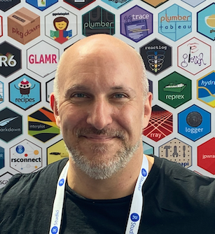
Stephan
Notes:
I’m Stephan Kadauke, and I’m an Assistant Professor of Pathology and Lab Medicine at the Children’s Hospital of Philadelphia. I see patients, run a clinical lab that deals with bone marrow transplants and other cell therapies, and I run an Informatics team that builds data products for clinical, regulatory, quality, and research operations of the clinical cell therapy program here at CHOP. My team created the REDCapTidieR package.

Slide 3
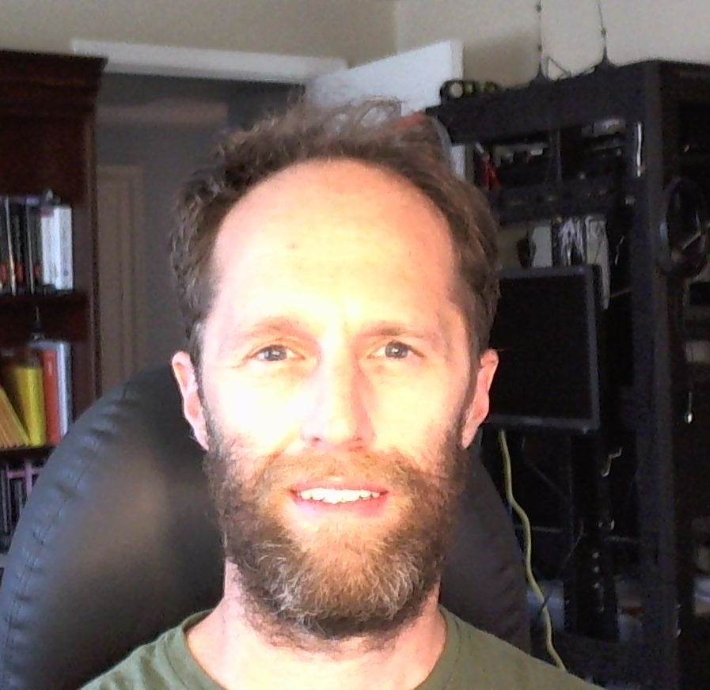
Will
Notes:
Will Beasley is a Professor at Oklahoma University. He is the creator and main contributor of the REDCapR package.

Slide 4

Assumptions
You have access to a REDCap database.
You have basic knowledge of R.
You're interested in learning how to pull data out of REDCap using R, and potentially be able to push data into REDCap as well.
Notes:
… but don't necessarily have in-depth knowledge about complex databases with repeated and longitudinal instruments
… but aren't necessarily an expert in using it to clean, visualize, or model data
… Either because you’re an analyst who needs to learn how to do this, or because you’re a REDCap admin who has to deal with people who use R to interact with REDCap, and you want to be able to point them in the right direction.

Slide 5
Orientation to the Workshop

Slide 6
REDCap + R: Teaming up in the Tidyverse!
Session | Presenter
Welcome and Introduction | Stephan
Extract and Explore | Will and Stephan
Transform and Visualize | (Offline: see GitHub repo)
Write to REDCap | Will
Recreate and Extend | Stephan and You!
https://github.com/skadauke/rmedicine_2024_redcap_r_workshop
Notes:
- Each session will be about 45 min, and we’ll do breaks after each one of them.
…
Because of time, we will have to skip the Transform and Visualize part, in which I’m teaching the basics of ggplot2 and how to graph some of the data we’ve downloaded from a REDCap database. You can find the slides (including a full script in the notes) as well as exercises in the repository.

Slide 7
Lecture slides
Notes:
We will introduce new concepts with lecture slides

Slide 8
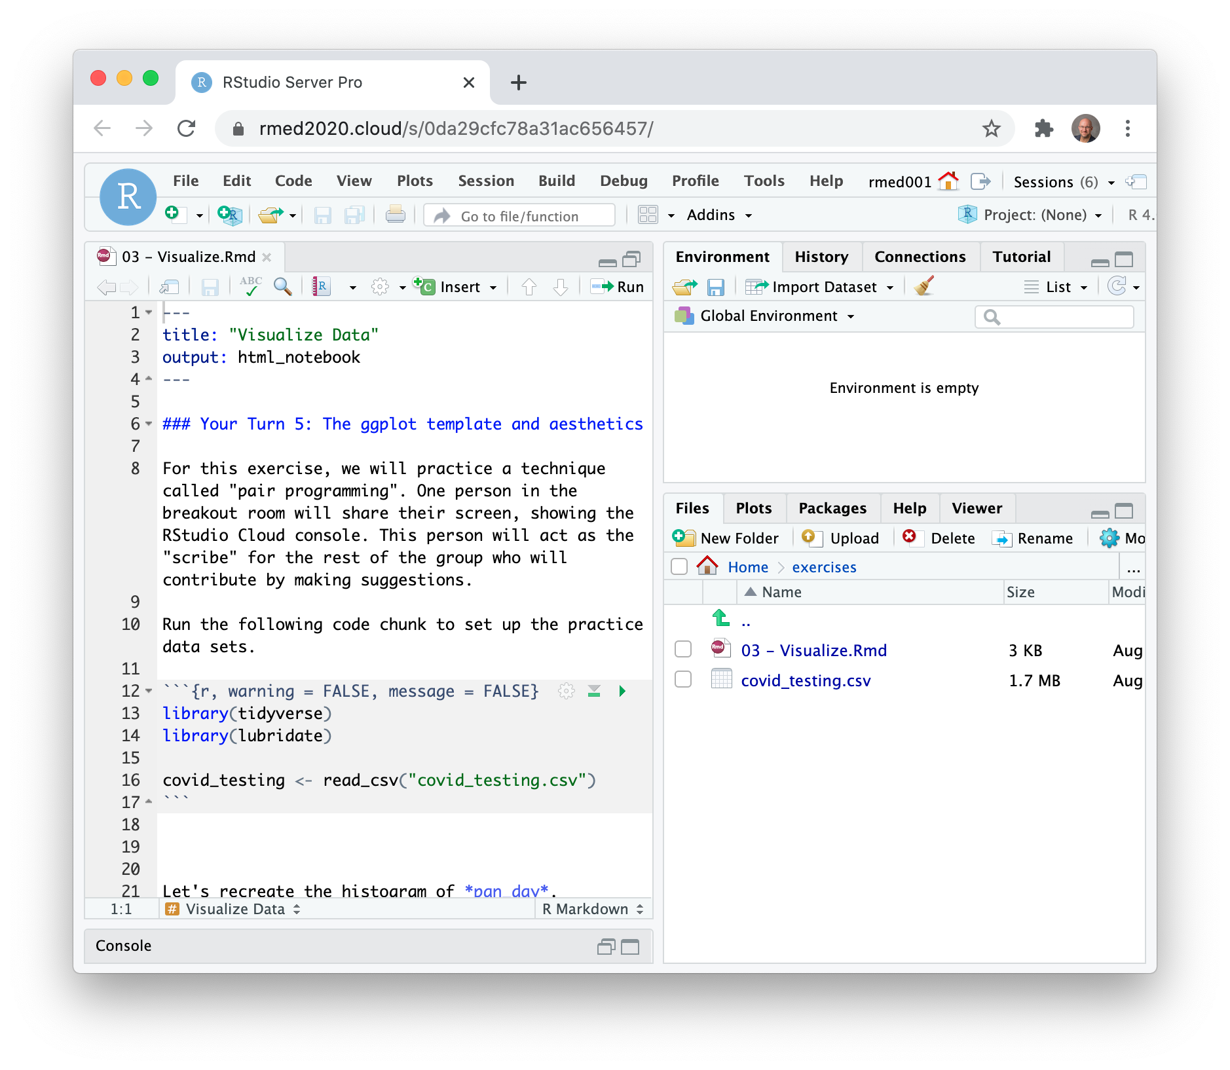
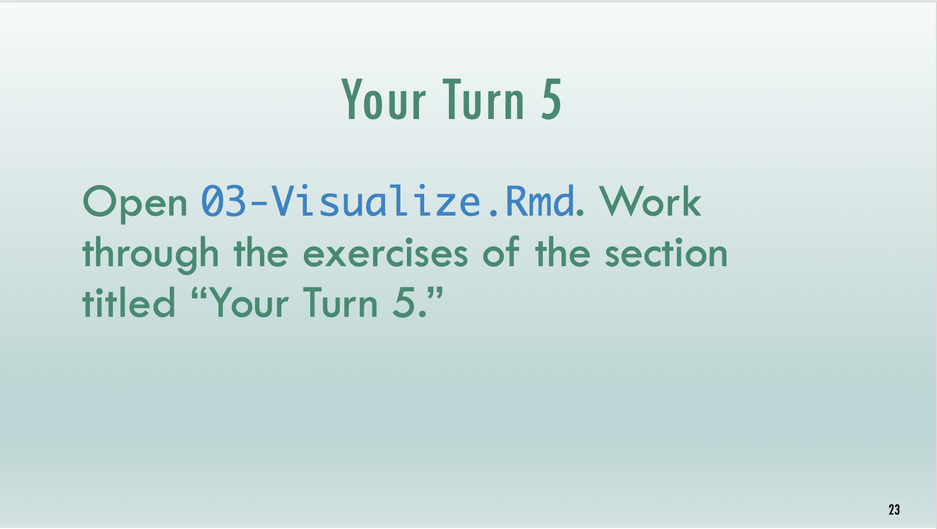

Timed interactive coding exercises
Notes:
And then practice these new skills with timed interactive coding exercises. You will work in a training environment on the web that we specifically set up for this course.
In some cases, we will walk through a tutorial written in Quarto together.
It's important to note that these exercises are timed. It's not essential that you finish each exercise, but it's essential that you try. When the time is up, we ask that everyone stop working and return to the main session. We will then live code the exercise to catch everyone up.

Slide 9
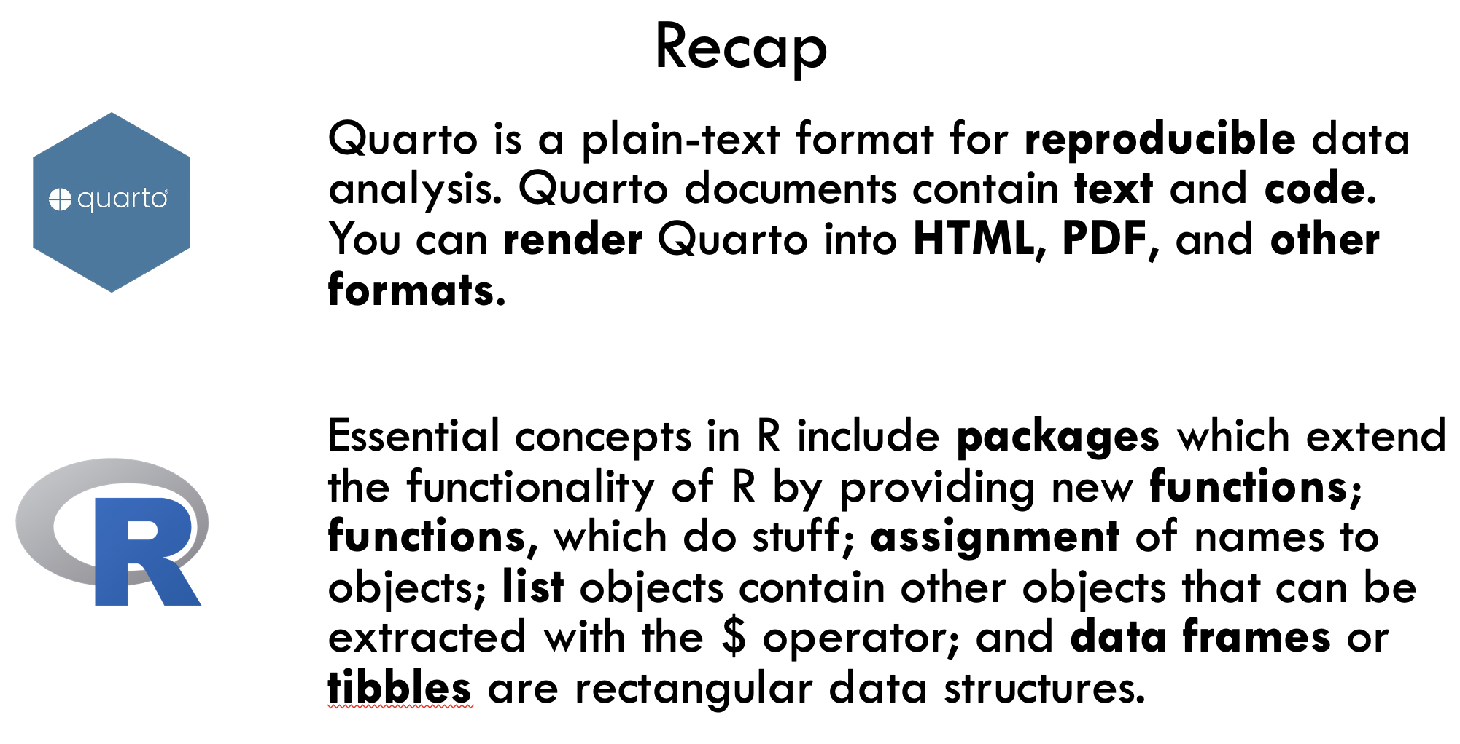

Recap and “What Else”?

Slide 10
Code of Conduct
Screenshots
Recordings
Photographs
Harassment
https://events.linuxfoundation.org/r-medicine/attend/code-of-conduct/
Notes:
One more serious thing we need to point out, since this is an interactive course - we want to provide a welcoming and supportive environment for all people, regardless of background or identity.
** So we have a strict no harassment policy: this includes abusive, offensive, or degrading language, in writing or voice
** for full CoC please take a look at the main website About > Code of Conduct https://events.linuxfoundation.org/r-medicine/attend/code-of-conduct/
** Also, to respect the privacy of participants, we don’t allow screenshots, recordings, or photographs.
If we find that you violate the code of conduct you may be removed from the course.

Slide 11
Getting Onto Posit Cloud
Notes:
We’ll be using Posit Cloud to do interactive exercises for this workshop. Posit Cloud is a web version of the RStudio IDE, and we’ve set up a Posit Cloud environment specifically for this session so you don’t have to download or install anything on your computer.
However, after the course we highly recommend you download the RStudio IDE from the Posit website. You can find some guidance on how to do this on Mac or Windows on the course website.

Slide 12
https://posit.cloud/content/6465016
Notes:
This is the address for the Posit cloud environment. Log in or sign up if you don’t have an account.

Slide 13
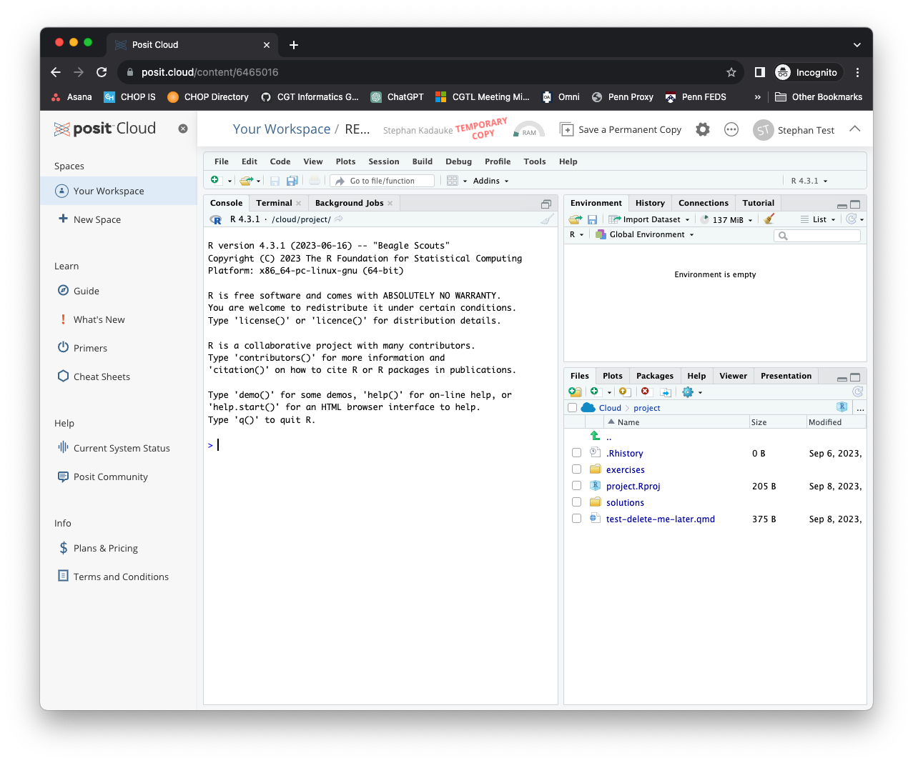
Notes:
Once you’re logged in, your screen should look like this. You can X out the left sidebar so you have more real estate on the screen.

Slide 14
Your Turn
In the Files pane on the bottom right, find the exercises folder. Click on it.
Then click on the file named 00_welcome.qmd.
A new pane will pop up on the top left with the contents of that file. Read what it says and follow the instructions to complete the exercise.
Notes:
This is our first exercise. If you’re watching this on YouTube, I suggest you hit pause and resume when you’ve finished the exercise.

Slide 15
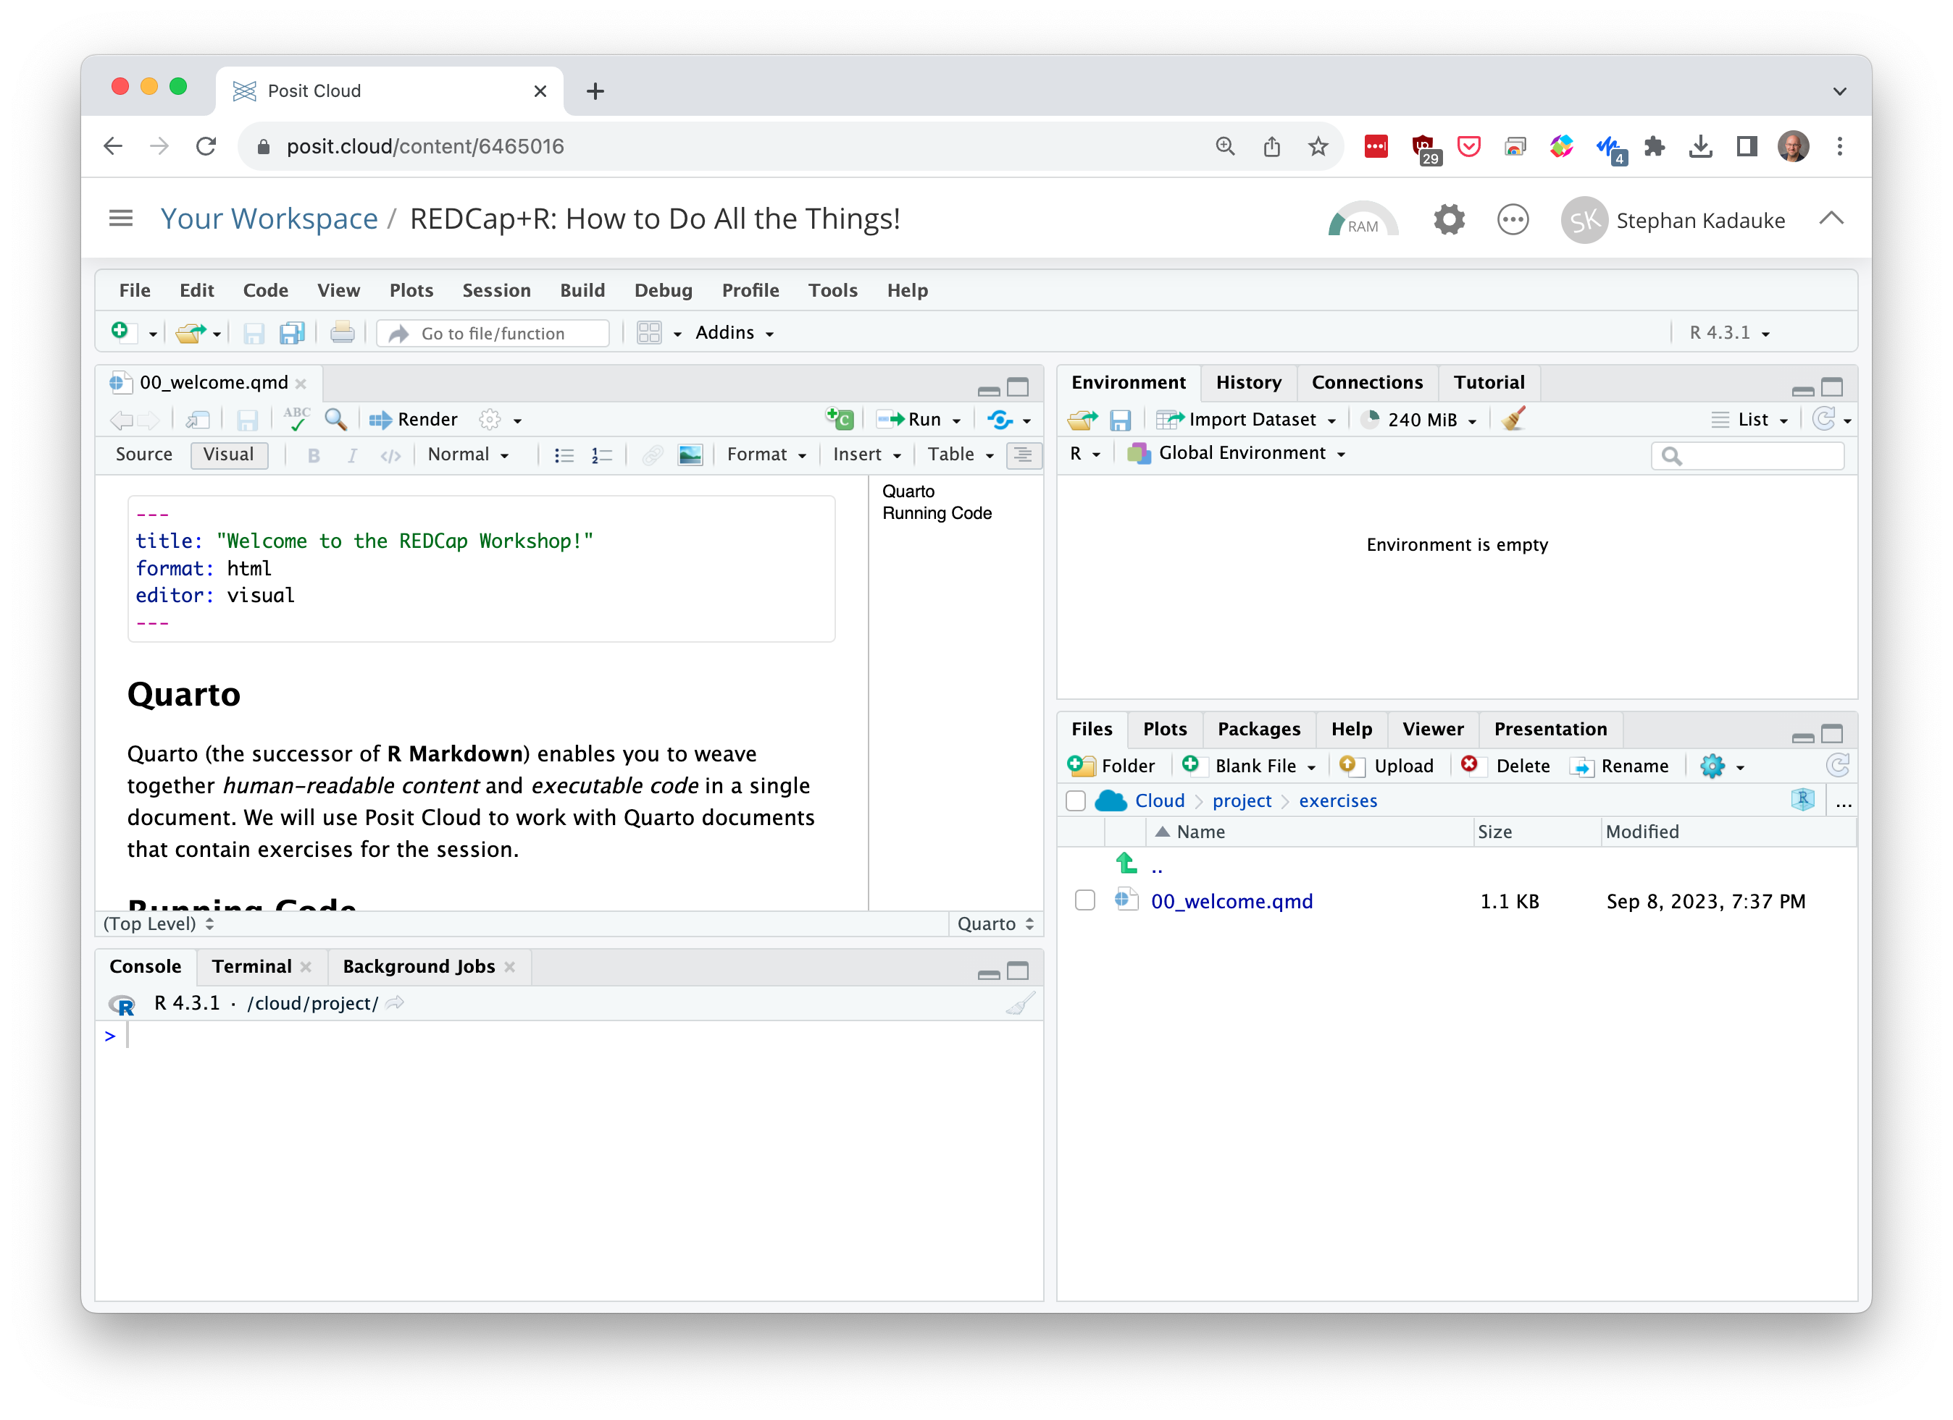
Environment
Editor
Files
(and other stuff)
Console
Notes:
Let’s talk about the RStudio or Posit IDE. Here is what it looks like.
On the top left is the editor. This is where you enter code.
On the top right is the Environment. The environment allows you to look at the data that’s loaded into R. Interacting with data in the environment tab provides some of the functionality you may be familiar with from working in Excel.
The Console is on the bottom left. You can use the console quickly run an individual R command, like install a package. As a general rule, you’ll want to minimize using the console and instead write code in the editor, even for simple things, because that’ll allow you to save your work for later which is key for reproducibility.
The pane I have labeled “Files and other stuff” has a couple of tabs. The most important one for today is the “Files,” and you’ve already explored that when you found the Quarto document with the exercise. But here’s also where help pages for R commands will show.
Now redo the exercise and run the code chunks.

Slide 16


Notes:
Let’s talk about Quarto! Quarto lets you write and share computational documents.
Quarto is a plain-text file format, which means that you can open in in a text editor and you can use it with tools like GitHub to track differences.
Quarto lets you compose documents that contain human readable content and computer code. We will use Quarto in this session and we encourage you to always use it in your future work when you do anything in R.

Slide 17
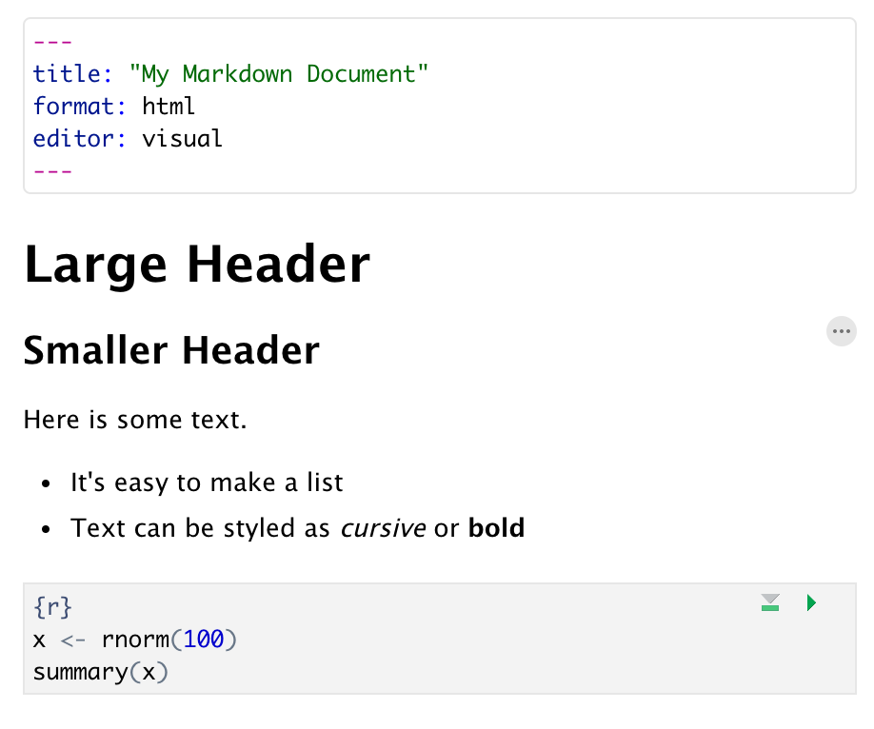
Anatomy of a Quarto Document
Header
Header
Text (with formatting)
Code chunk
Notes:
Quarto documents are composed of 3 basic building blocks.
**The first is the Header which includes information like the name of the document, the document’s author, and the desired output format. You can recognize it because it always starts with three dashes and ends with three dashes. The information written inside is YAML, which is a human readable key-value data format. For example, here we see that the title of the document will be “My Markdown Document”; and that we want the format that comes out when we render the document as HTML; and that we want to use the Visual Editor, which is the default user friendly editor of the Rstudio IDE.
**The second building block of Quarto is text. This supports a limited degree of formatting to make things more readable and nicer looking. For example, you can make large or smaller headers, and you can make bulleted and numbered lists, and you can style text as cursive and bold. You can also add hyperlinks easily.
**The final building block is code chunks. Code chunks are where the R code goes. In contrast to writing an R script which is a long piece of code, code chunks are typically quite short, which makes it easier to reason about them. While you’re working on your Quarto document, you can execute code chunks individually. Or you can render the entire document into HTML or some other presentation format, and this will run all code chunks in sequence. This may not seem like a big deal but it is: this way you get a completely reproducible data analysis.

Slide 18
Introduction to R
Notes:
For those of you who haven’t done much work with R, so I want to give here a minimal introduction with just enough detail to make sure everything that follows make more sense.

Slide 19
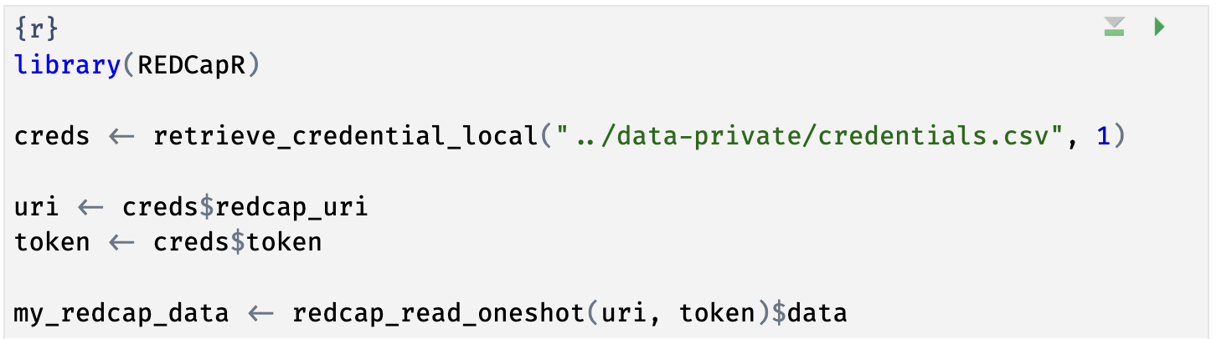
Notes:
Here’s the code chunk you just ran. This code looked up credentials to a REDCap project in a local file, and then downloaded the data from that REDCap project via the REDCap API, facilitated by the REDCapR package. If you haven’t looked at R code before, this will look very strange. In the next few slides I’m going to demystify this code.

Slide 20
The Data Analysis Pipeline
Notes:
In R, we think about the data analysis pipeline. This includes importing data, cleaning or tidying it, and then you can visualize and model it to gain insights into the data. Finally, you need to communicate these insights. One of the reasons we use the Posit/RStudio IDE and Quarto is because they provide a lot of tools to help with every one of these steps.
The first step in the data analysis pipeline is to import the data into the R environment. Data can be in the form of Excel or CSV files, or they can come from online resources. For today, we’ll focus on getting data from REDCap into R.

Slide 21
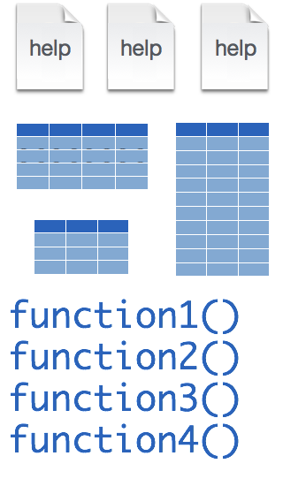

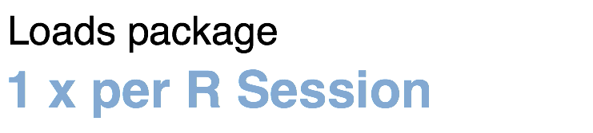
Installing and loading R packages
REDCapR
install.packages("REDCapR")
library("REDCapR")
Notes:
Much of R’s functionality comes in open-source packages. Two of these packages we’ll discuss in some detail today are the REDCapR and the REDCapTidieR packages.
At its core, a package, such as REDCapR, contains functions, documentation, and sometimes data.
Fortunately, installing packages is super easy, with the command install.packages. So let’s say you want to install a package named “REDCapR”. You go to the R Console and type install.packages(“REDCapR”).
Each package you want to use needs to be installed only once on each computer. But to actually use the functions in the package, you also need to load the package. This is done with the command “library”. So to enable all the functions in the “REDCapR” package, you type library(“REDCapR”). And in fact, library(REDCapR) was the very first line of code in the code chunk in the exercise you ran earlier.
Packages remain loaded until you quit R. So every time you start a new R session you have to load each package that you want to use again.

Slide 22
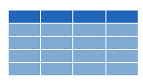


retrieve_credential_local()
creds <- retrieve_credential_local(file_name, pid)
csv
file_name.csv
REDCap PID
Notes:
Let’s look at the next line of code in that chunk. It reads, …
There is a lot of R going on in this line of code. What is does is that first calls a function named retrieve_credential_local(). This function is part of the REDCapR package. It looks at a special CSV file with REDCap credentials, such as an API token and project IDs, and this function returns some information with these REDCap credentials. This information is then stored as an object named creds in R’s memory.
Why do we use that function for this? Because this way we don’t have to hardcode credentials into our R code, which is considered bad practice. So REDCapR makes it easy for you to do the right thing!

Slide 23
object
(stores output)
function
(does stuff)
arguments
(inputs)
creds <- retrieve_credential_local(file_name, pid)
assignment operator
(“gets”)
Notes:
Let’s look a little bit closer at what happens here. First, we have retrieve_credential_local, which is a function. Functions are super important in R.
Functions take zero, one, or more inputs, and they return one output.
** The inputs are called arguments and go into parentheses. If there’s more than one argument, they get separated with commas.
** You can capture the output in an object,
** using the assignment operator. This is a smaller than sign followed by a minus or dash and is supposed to look like an arrow pointing left. In other languages this assignment operator is a single equals sign, and one of the quirks of R is that they use this arrow looking sort of assignment operator instead. People pronounce this operator as “gets” … as in creds ”gets” retrieve_credential_local “of” filename and pid.

Slide 24
uri <- creds$redcap_uri
list
creds
redcap_uri | "https://redcap.chop.edu/api/"
username | "myusername"
project_id | 1
token | "37BCFC38D45F10C47EAF4D8B97BFC32F"
comment | CAR-T cell trials
uri
"https://redcap.chop.edu/api/"
Notes:
Let’s look at the next line. This says, uri <- creds $ redcap_uri
The creds object which we just made in the previous command is a *list*. A list is an object that contains other objects. In this case, “creds” contains the following elements: redcap_uri, username, project_id, token, and comment.
The $ operator extracts an element from a list. In this case we’re extracting the redcap_uri element and then we’re storing it as an object named ‘uri’.

Slide 25
dollar operator
extracts an element from a list
uri <- creds$redcap_uri
list
a type of object that can contain
multiple arbitrary objects
Notes:
…

Slide 26
Your Turn
Write the R code to extract the element named token from the creds object and store it in an object named token.
Notes:
If you’re watching this on YouTube, write this down on a piece of paper or somewhere else and then compare your answer with the solution that will appear in just a minute.

Slide 27
token <- creds$token
Notes:
…

Slide 28
Notes:
We actually just went through the first four lines of this code chunk! Let’s look at the last line.

Slide 29
my_redcap_data <- redcap_read_oneshot(uri, token)$data
data frame (tibble)
list
... | ...
data
Notes:
This line reads, …
So we’re calling the redcap_read_oneshot() function from the REDCapR package, giving it the URI and token as inputs. But then there’s this $data thing at the end. What does that mean?
To understand this you have to first realize that the output of redcap_read_oneshot is a list. That list has a bunch of information about the REDCap database, but importantly, it has an element named “data” which contains the data from the REDCap project. We can use the function call as if we already knew that we’ll be getting back a list, and then use $data to just extract that data, and discarding all the other information of the list.
Then we use the assignment operator to store the data in an object named my_redcap_data.
** So again, the redcap_read_oneshot() function takes the URI and API token as inputs and returns a list, that contains a ”data” element.
** This data element contains a type of object that’s called a data frame or tibble. This is similar to an Excel sheet in that it has rows and columns.
** So we’re only extracting that data frame and assigning it to an object named my_redcap_data.

Slide 30

Recap
Quarto is a plain-text format for reproducible data analysis. Quarto documents contain text and code. You can render Quarto into HTML, PDF, and other formats.
Essential concepts in R include packages which extend the functionality of R by providing new functions; functions, which do stuff; assignment of names to objects; list objects contain other objects that can be extracted with the $ operator; and data frames or tibbles are rectangular data structures.
Notes:
And this is your 5 minute intro to R!
To recap what we covered up to this point, we looked at Quarto documents…

Slide 31
Introduction to REDCap
Notes:
For those of you who haven’t done much work with R, so I want to give here a minimal introduction with just enough detail to make sure everything that follows make more sense.

Slide 32

What is REDCap?
A secure, web-based application designed for data collection and management in research studies.
Used by thousands of institutions worldwide.
Popular in the fields of academic research, clinical trials, and public health
Notes:
And this is your 5 minute intro to R!
To recap what we covered up to this point, we looked at Quarto documents…

Slide 33
REDCap Sessions at R/Medicine 2024
Date / Time | Presenter | Session Title
June 12, 2:30 PM | Brandon Rose (U Miami) | RosyREDCap - a REDCap-project-agnostic R package that uses an API token to make a single, updating, standardized R list object containing all metadata and data for exports, imports, transformation, and shiny applications
June 14, 2:46 PM | Peter Higgins (U Michigan) | Automating Sharing of Data Summaries from REDCap, Googlesheets, and Qualtrics with Quarto Webpages and Automated Emails
June 14, 3:55 PM | Savannah Obregon (Vanderbilt) | redcapAPI: Analysis-Ready Data Retrieval from REDCap with Advanced Processing Capabilities in R

Slide 34
Why use REDCap?
Can handle diverse types of data collection needs:
Longitudinal studies
Repeated measures
External-facing surveys
User-friendly web interface for designing databases and surveys.
Real-time data validation during data entry.
Built-in audit trails and logging for tracking data changes.
REDCap is 21 CFR Part 11 “ready”
Advanced user rights and control.
Data Access Groups allow multicenter collaborative data entry with strict access control

Slide 35
Example Projects Using REDCap
Clinical Trials: Managing participant data, treatment schedules, and follow-up information.
Public Health Surveys: Collecting data from diverse populations to study health trends.
Academic Research: Gathering data for dissertations, manuscripts, and collaborative research projects.
Registry Databases: Maintaining comprehensive records for rare diseases or specific patient cohorts.
Notes:
We’re going to focus on #1 – Clinical Trial data capture.

Slide 36
CAR-T Cell Therapy and Clinical Data Management

Slide 37
Pediatric leukemia
Survival in B cell acute lymphoblastic leukemia (B-ALL) in children approaches 90%
But only 1/3 of children survive relapsed disease or primary refractory leukemia
Traditional approach has been intensive chemotherapy followed by hematopoietic stem cell (bone marrow) transplant
The advent of CAR-T cell therapy 12 years ago has shifted the landscape for children with relapsed or refractory B-ALL
Notes:
B-cell leukemia is the most common cancer in children. Although the prognosis is generally good, with cure rates after chemotherapy close to 90%, and only one in three children who relapse or have leukemia that’s refractory to chemotherapy will survive.
Historically, the approach involved intensive chemotherapy followed by a stem cell (or bone marrow) transplant. However, the advent of CAR-T cell therapy a decade ago has significantly changed the treatment landscape for these challenging cases.

Slide 38
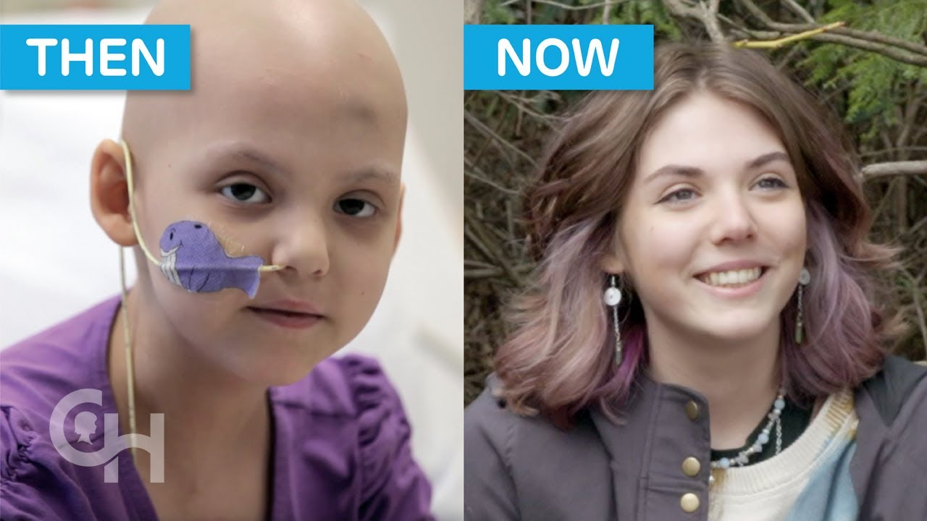
Notes:
Let me introduce you to Emily Whitehead. In 2012, at just 6 years old, she came to CHOP with relapsed B-ALL that wasn't responding to chemotherapy. And she was so sick that a bone marrow transplant was off the table.
Emily became the first pediatric patient to receive CAR-T cells through a new clinical trial led by Steve Grupp. This innovative treatment eradicated her cancer cells, and they have not reappeared since.

Slide 39

Notes:
Fast forward to last year. In March of 2022, Emily celebrated a decade post-CAR-T cell treatment, marking her as the first patient to be cured by this revolutionary therapy.
Though it's still early to determine overall cure rates for CAR-T cells, we believe a significant number of patients with relapsed or refractory B-ALL could potentially find a cure with a single dose of CAR-T cells.
And this is nothing short of amazing. In oncology, it’s incredibly uncommon to see a single treatment with a single therapeutic agent achieve such a remarkable outcome.

Slide 40
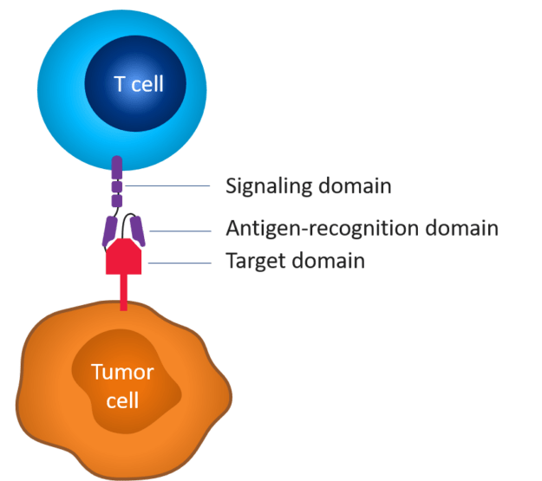

What’s a CAR-T cell?
Notes:
Let's delve into the fascinating world of CAR-T cells.
Essentially, a CAR-T cell is a genetically modified T cell, represented here in blue. It's designed to produce a chimeric antigen receptor, or CAR, visualized in purple. And this CAR enables it to identify, bind to, and kill a tumor cell, which is shown in orange. And it does so because the CAR can recognize some target protein on the tumor cell.
The CAR is built of an extracellular component, derived from an antibody's antigen-recognition domain, and an intracellular part consisting of a signaling domain that activates the T cell.
An important aspect of CAR-T cells is that they are a living drug. They can divide and persist in the patient's body. And each CAR-T cell can eliminate many tumor cells.

Slide 41

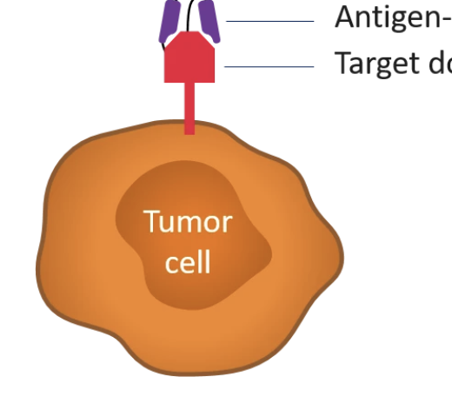

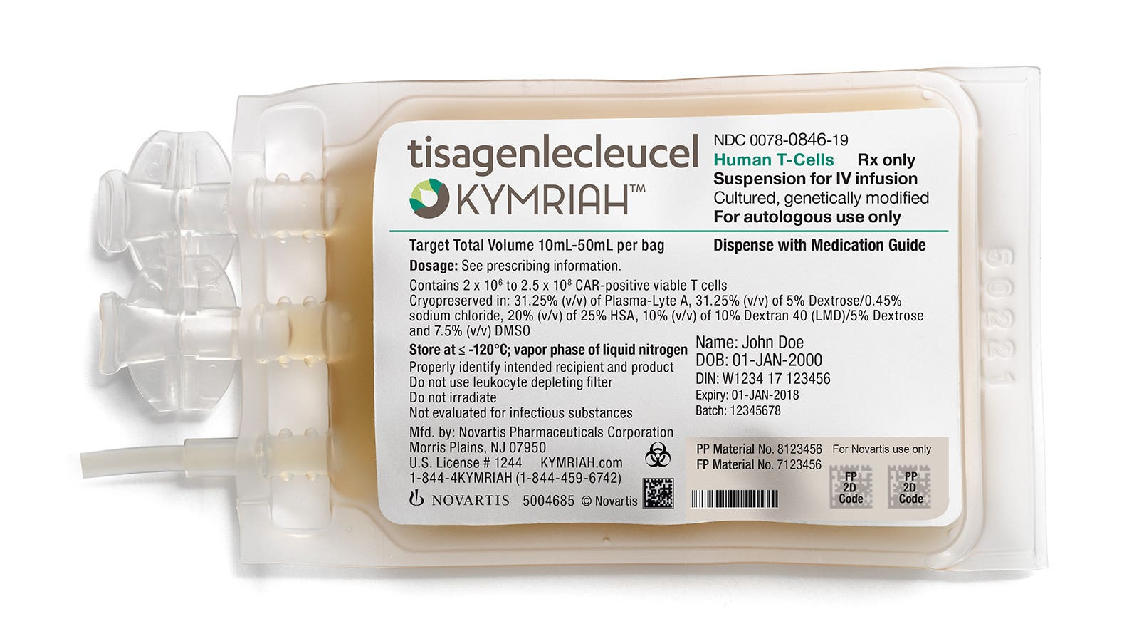
CD19-directed CAR-T therapy
CD19 is present on normal B cells and B-cell malignancies
You can live without B cells
CD19-directed CAR-T cells are safe and effective
Tisa-cel (Kymriah) FDA approved in 2017
CD19
Notes:
So, what makes a good target for B-ALL? CD19 is a compelling answer, and here’s why.
CD19 is a protein expressed on all normal B cells throughout their development until they differentiate into plasma cells. It is restricted to B cells. You don’t have any CD19 on blood stem cells and other tissues. And fortunately, most B cell cancers express CD19.
The key point is that humans can survive without B cells, so that decreases the risk of CAR-T cells attacking vital tissues.
Our group and others have shown that CD19-targeted CAR-T cells are safe, achieving complete response in 70-90% of pediatric patients with relapsed/refractory ALL, with some patient achieving durable remission. However, like I mentioned earlier, the exact cure rate is still unclear as we're only now reaching a decade since the first treatments.
Outcomes from a large multicenter trial of CD19-directed CAR-T cell product (the same that Emily received) led to the approval of tisagenlecleucel (Kymriah) by the FDA in the US, making it the first FDA approved CAR-T therapy.

Slide 42
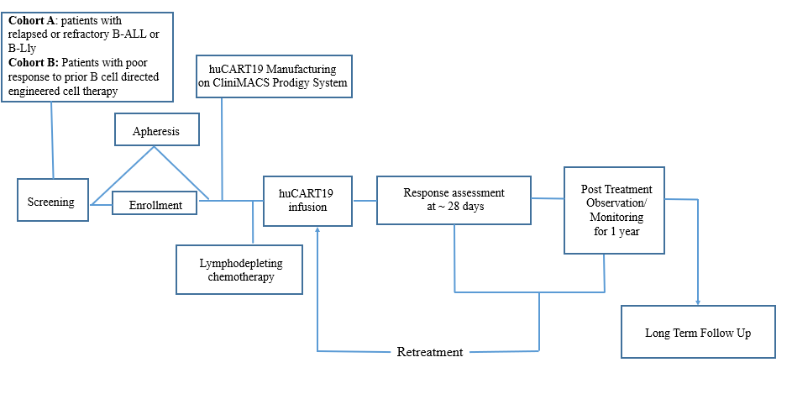
Study schema of a CAR-T cell clinical trial
Notes:
Here's the study schema. We have two cohorts: patients who've previously received and failed CAR-T therapy, and first-time CAR-T therapy recipients.
After consent and enrollment, T cells are harvested from patients by a process called apheresis. Following this, we manufacture the CAR-T cells in our lab. Patients undergo lymphodepleting chemotherapy (and this makes room for the incoming CAR-T cells), and then they receive a single dose of humanized CD19-directed CAR-T cells.
We then evaluate the effectiveness of the treatment with a marrow biopsy and lumbar puncture on day 28, followed by a 12-month follow-up period during which we see the patient on multiple visits. After the 12 months, patients are enrolled in a 15-year long-term follow-up study.
To date, we have successfully manufactured products for eight patients, infused six patients. Four out of four patients for which we have 28 day-data have responded!

Slide 43
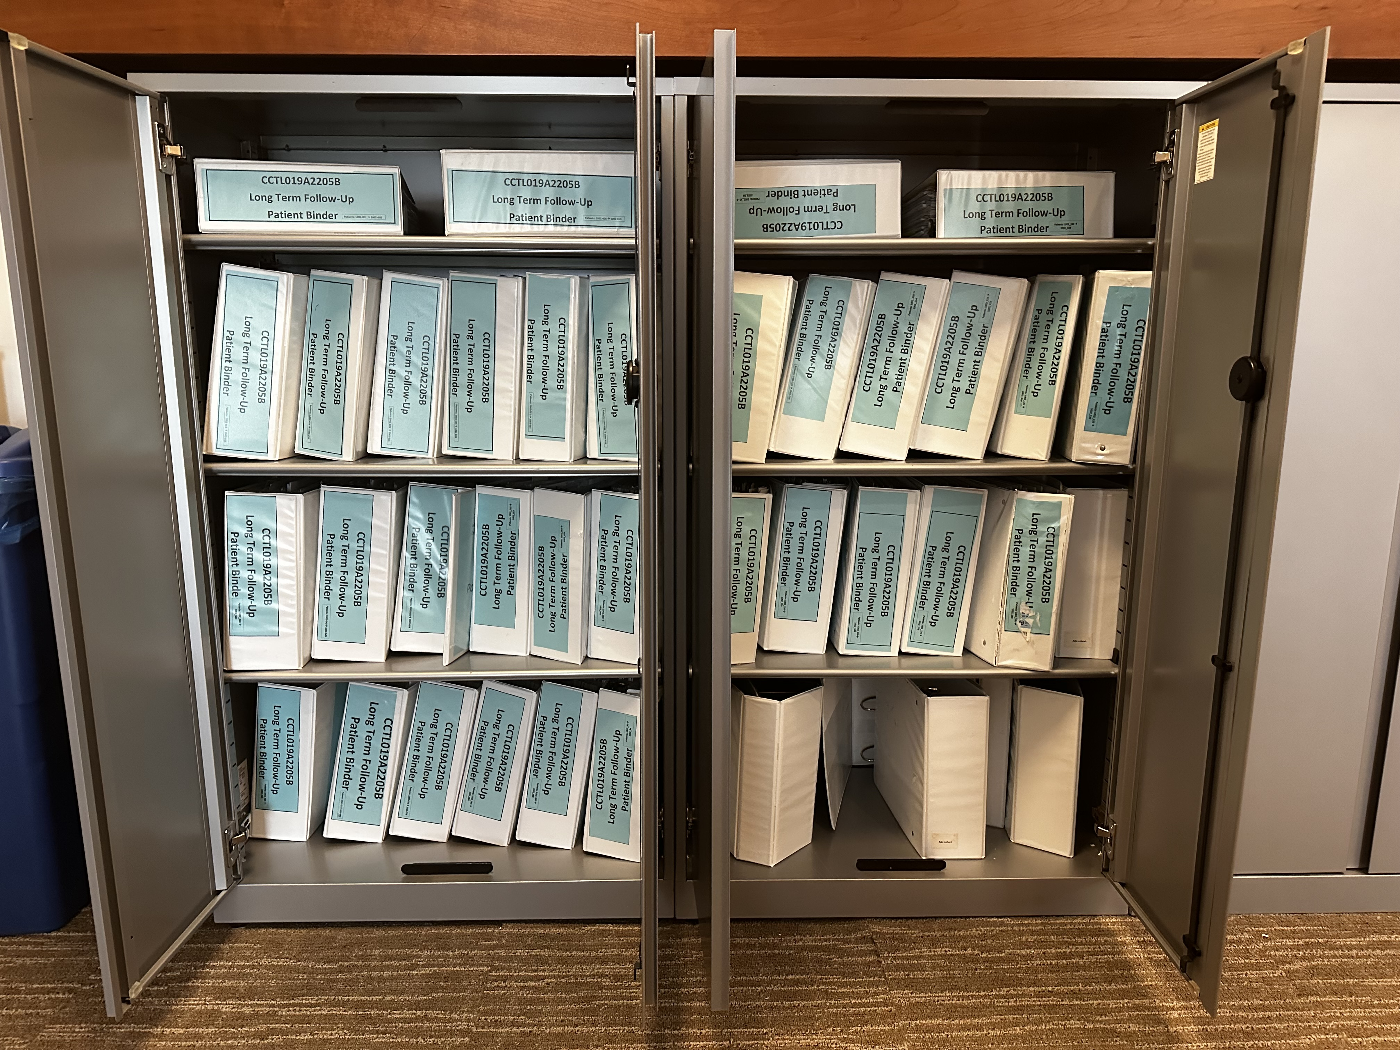
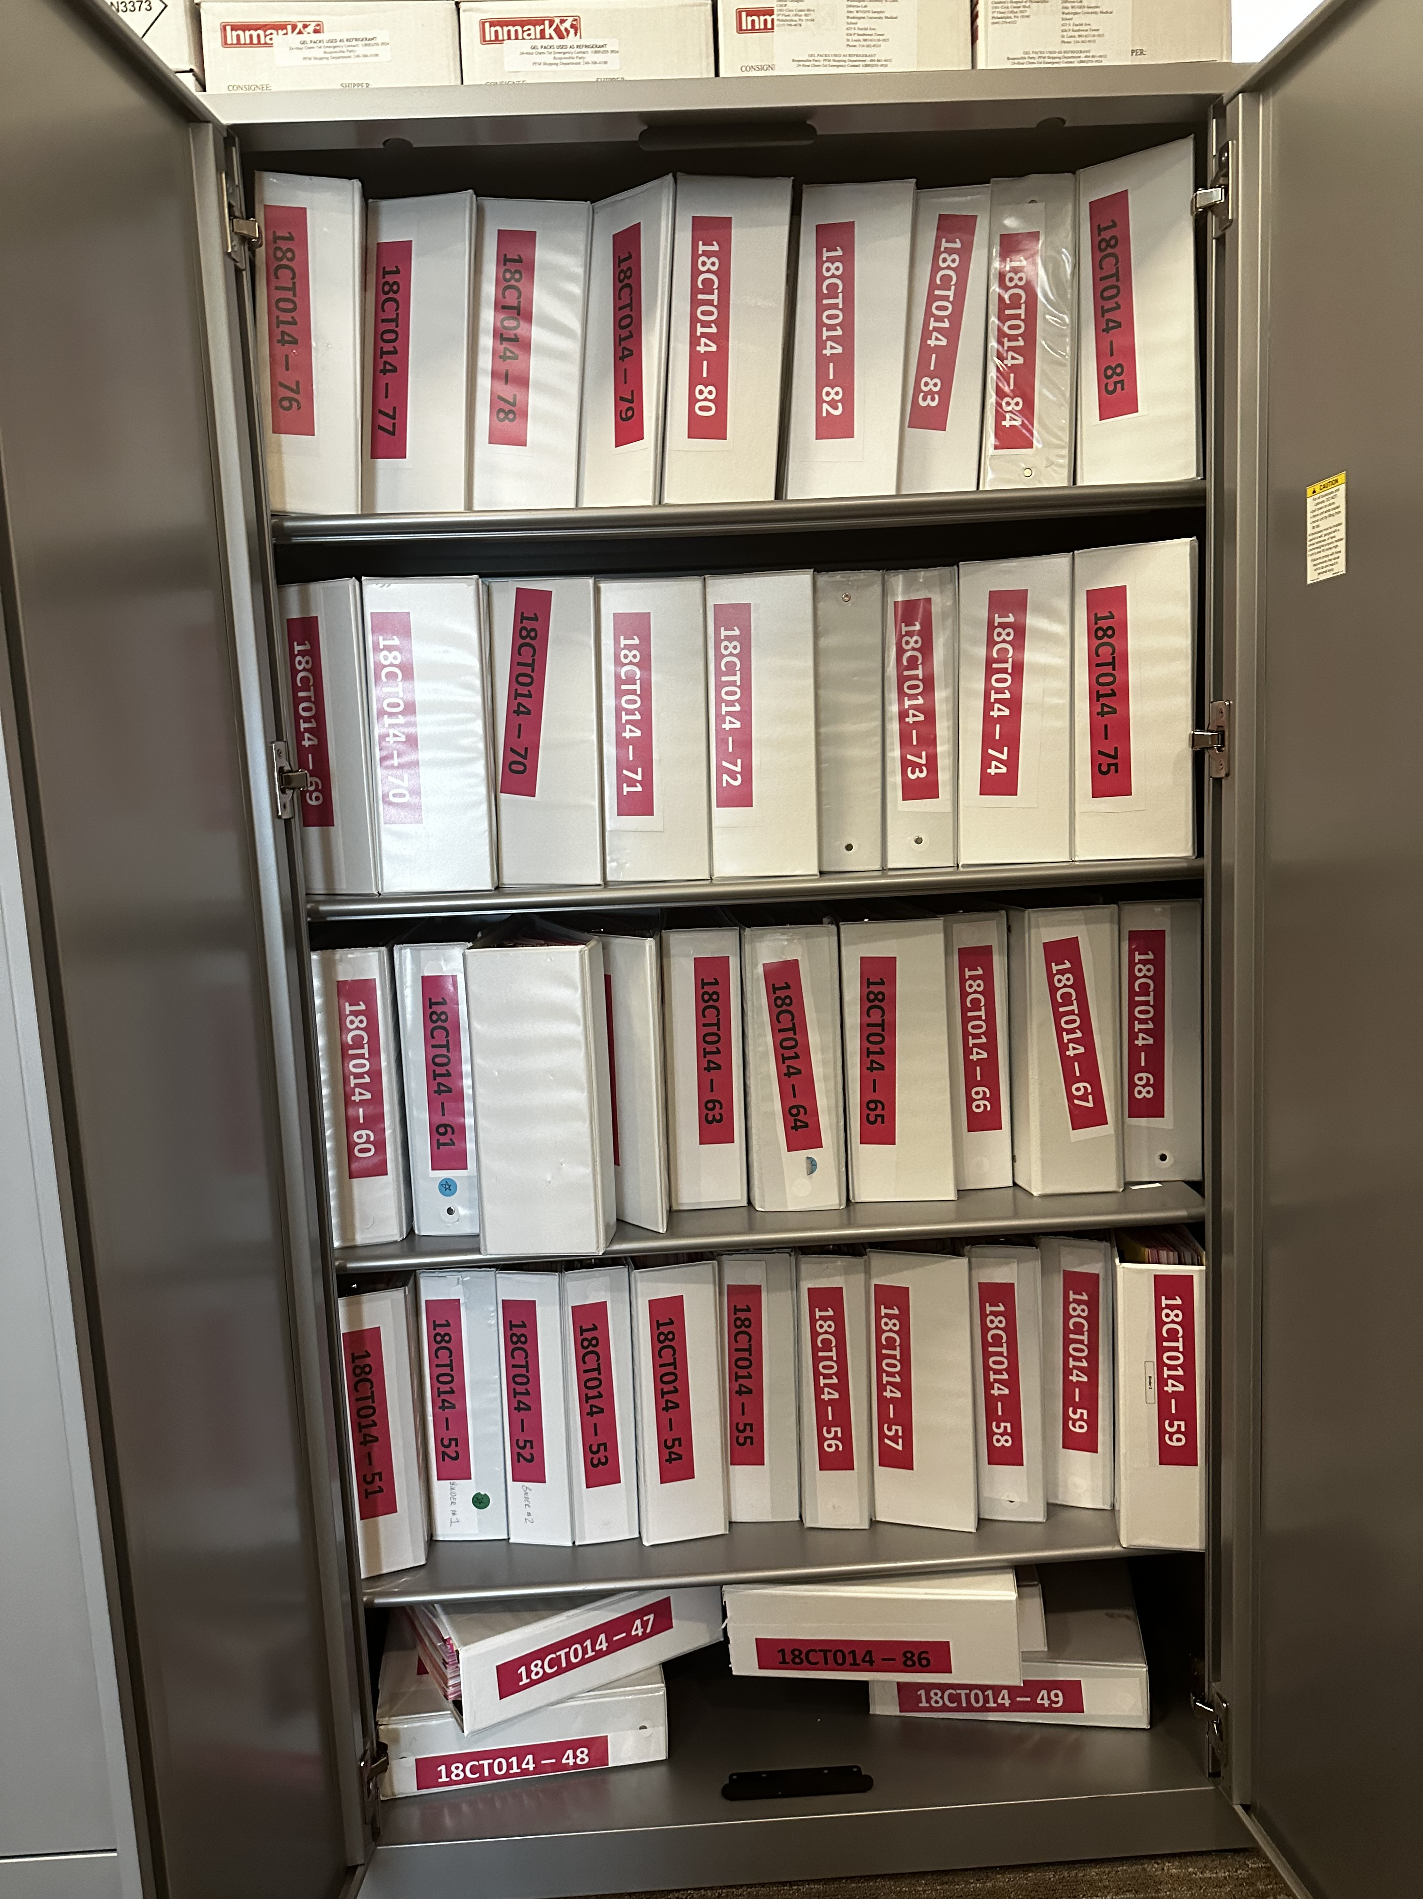
Notes:
All of these trial visits generate a lot of data, and we used to capture all of this on paper. Each patient on a CAR-T trial gets a binder like this, and we’ve treated almost 500 patients on clinical trials so far. So what you’re seeing here is just a small fraction, maybe 10%, of the binders we have at CHOP just for CAR-T patients.
A vast effort goes into data collection, but there isn’t a clear pathway to getting value out of this. Usually, trial monitors look at the binders and use them to collect data in spreadsheets. Researchers who would like to write papers often ignore these binders entirely, and instead choose to manually extract relevant data from the medical record directly. There are a lot of papers that were never written or published much later than would have been possible because of these challenges.
And so our objective here was to overhaul this process by digitizing CAR-T clinical trial data capture and developing automated real-time analytics.
I think that this will have many benefits. For example, we should be able to identify issues that require intervention earlier, and this might improve patient outcomes. We completely expect that this will streamline the generation of research abstracts and publications, boosting researchers' productivity by allowing for more and earlier publications from each trial. And finally, a standardized and partially-automated approach to data capture and analysis should reduce the labor required to initiate and conduct new clinical trials, leading to more and cheaper trials overall.

Slide 44



Building the end-to-end trial analytics pipeline
EHR
EDC
Dashboard
Notes:
Now, let's discuss how we built the end-to-end trial analytics pipeline:
The basic idea is that data gets abstracted from our Electronic Health Record (EHR) and then goes into an electronic data capture (EDC) system that we’re custom-building using REDCap. Then, that data gets automatically pulled into a Shiny dashboard that displays relevant tables and graphs.

Slide 45
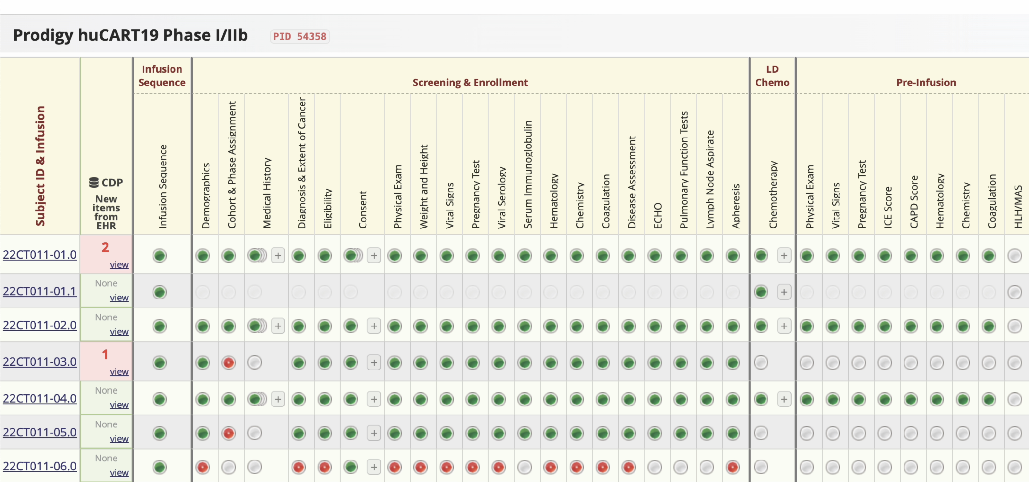
REDCap-based electronic data capture (EDC)
Notes:
Exploring the REDCap-based electronic data capture (EDC) further:
We chose REDCap for several reasons. It's available at CHOP, it's free to use, it's secure for storing sensitive information, and we have complete control over data entry instruments configuration and data handling.
The database, as shown in this screenshot, is longitudinal. It allows us to document repeat measures, such as repeated labs, once for each visit. In addition, we capture adverse events. Adverse events don’t fit neatly into the longitudinal paradigm, but REDCap lets us manage them using a repeated instrument setup.
*** We've also incorporated clinical data pull (CDP). CDP is a relatively new REDCap feature that automatically pulls data like demographics, vital sings, and labs from the EHR, and that saves considerable time and reduces data entry errors.

Slide 46
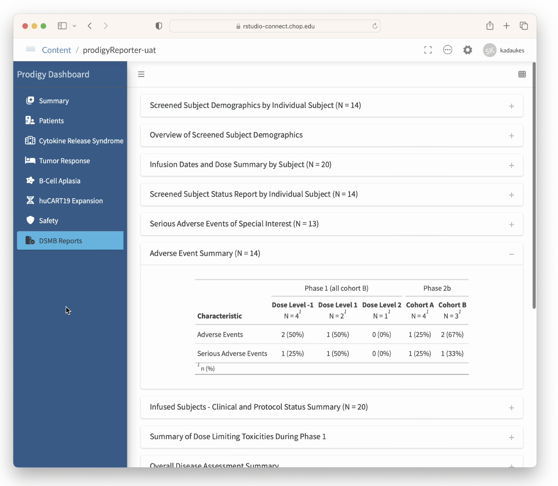




Shiny-based real-time CAR-T trial dashboard
Notes:
Now, let's look at the Shiny-based real-time CAR-T trial dashboard:
We decided to use Shiny because we obviously love R! And because we can securely store sensitive information on our RSConnect instance behind our hospital firewall.
Here you see a Data and Safety Monitoring Board report view, with an Adverse Event summary table breaking things down by phase, and whether the event was serious or not serious.
We architected the dashboard so that each analytic object, i.e. each table or graph, is an independent unit that can be unit-tested.
We also set up data entry trigger and caching mechanisms that make the dashboard always up-to-date and lightning fast. Whenever someone enters new data into the REDCap database, the affected analytic object gets rebuilt and stored inside of a pin.
*** We owe a great deal to the R community in building this, utilizing several packages including bs4dash, gtsummary, golem, DT, and of course the tidyverse suite.
However, we encountered a significant hurdle early on. The REDCap API output is far from user-friendly when dealing with a complex project, like one that is longitudinal or has repeating elements, or both. We recognized the need for a package that makes importing complex REDCap projects into R easier, leading us to create one ourselves.

Slide 47

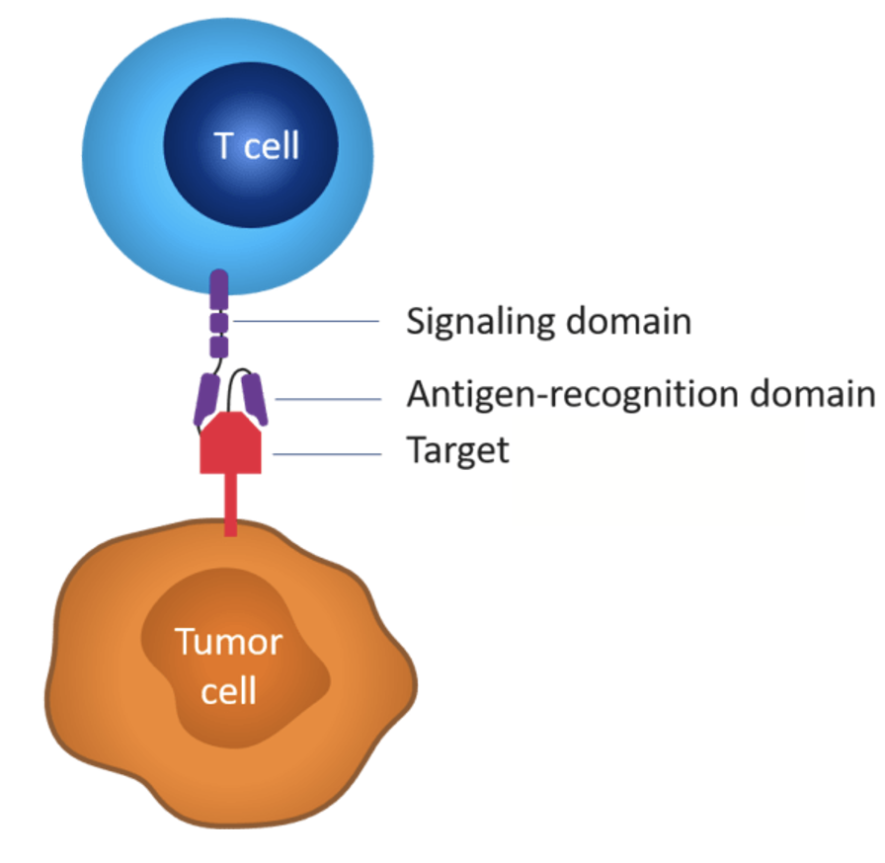
Recap
REDCap is a secure, web-based application designed for efficient data collection and management in research. It offers customizable forms, advanced user rights control, making it ideal for a variety of studies including longitudinal research.
CAR-T Cells are genetically engineered T cells used in immunotherapy to target and destroy cancer cells. This treatment has shown remarkable success, including the case of Emily Whitehead's complete remission from B-cell acute lymphoblastic leukemia.
Clinical Trial EDCs (Electronic Data Capture systems) based on REDCap can streamline the process of data collection and management for the trials. Integrated with systems like Epic and Shiny, they enable real-time data visualization and automated report generation.

